Slide 1
AIMS OF ANTHRAX LECTURE
Identify the anthrax, the micro-organism cause the disease
Clarify the different routs of transmission of anthrax
Identify the clinical presentation of anthrax according to frequency, severity and mode of presentation.
Discuss the methods to diagnosis the anthrax
Mention the drugs used to treat
Discuss the preventive measures of anthrax
Define the bioterrorism and discuss the role of anthrax and other microorganism

Slide 2
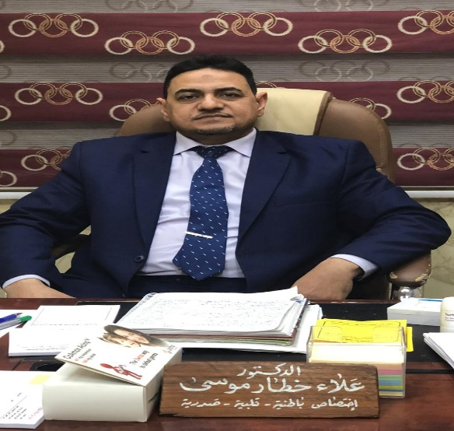
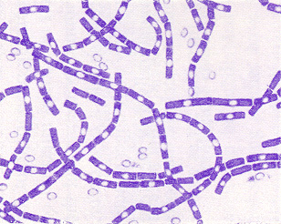
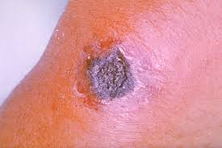
Anthrax
Bacillus anthracis
Malignant pustule , M. odema , Woolsorter disease
Anthrax is a serious infectious disease caused by gram-positive, rod-shaped bacteria known as Bacillus anthracis.
Anthrax can be found naturally in soil and commonly affects domestic and wild animals around the world

Slide 3
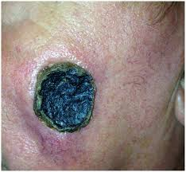
Transmission
skin contact
Inhalation ; bioterrorism
eating undercooked meat

Slide 4
Transmission:
→ Zoonotic infection
· Contact with tissues of infected animals (cattle, sheep, goats, horses, pigs and others)
· Biting flies that fed on such animals.
· Contact with contaminated hair, wool, hides or products made from them (e.g. drums, brushes, rugs).
· Contact with soil associated with infected animals in endemic areas may remain infective for many years.

Slide 5
Transmission cont.
· Inhalation anthrax results from:
→ inhalation of spores in risky industrial processes—such as tanning hides and processing wool or bone— with aerosols of B. anthracis spores in an enclosed, poorly-ventilated area.
· Intestinal and oropharyngeal anthrax may arise from ingestion of contaminated undercooked meat; there is no evidence that milk from infected animals transmits anthrax.

Slide 6
Transmission cont.
· Anthrax is not transmitted person to person.
· Accidental infections may occur among laboratory workers

Slide 7
Clinical manifestations:
Anthrax is an illness with acute onset.
· characterised by several distinct clinical forms including:
1. a skin lesion
2. a respiratory illness
3. abdominal distress
· Ninety percent of cases are cutaneous anthrax

Slide 8
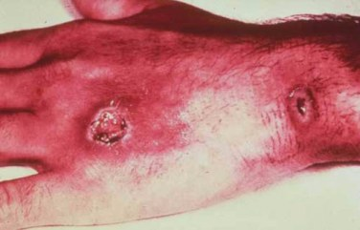
Clinical manifestations
Cutaneous: 95%.
occupational ( Veterinarian, butcher, Zoo keeper
Spores infect skin- edema develops at the site (Papule- Vesicle-Malignant Pustule-Necrotic ulcer)
painful Lymph glands & painless ulcer
Deaths rare.

Slide 9
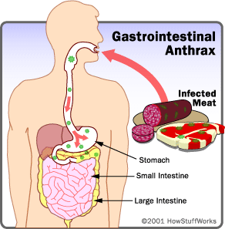
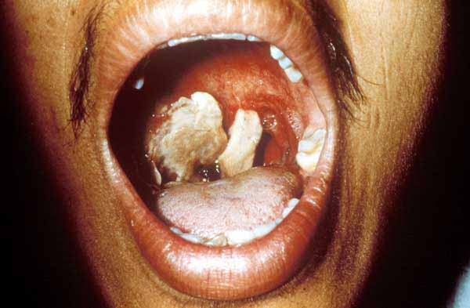
2- Gastrointestinal anthrax
Oro pharangeal
Intestinal anthrax
results in death in up to 60%

Slide 10
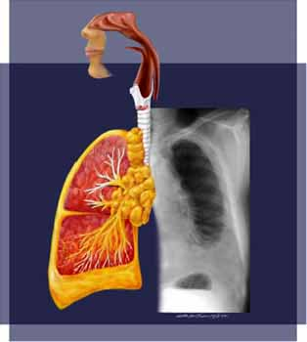
Inhalation anthrux
Mortality rate is very high > 95%
Fever , dyspnoea, cough
Septecemia
Chest X-ray ; widden • Haemorrhagic mediastinitis,
pleural EF.
Anthrax Meningitis
Subarachnoid haemorrhage
· Very often fatal
.

Slide 11
How is anthrax diagnosed?
Gram stain , immunofluorescence & Culture
Rapid detection methods
- PCR
- ELISA assay
X-ray and Computed Tomography (CT) scan of chest

Slide 12
TREATMENT
Penicillin is the drug of choice for cutaneous anthrax and is given for 5–7 days.
Tetracyclines, erythromycin are also effective.
· parenteral ciprofloxacin or doxycycline for inhalation anthrax though the duration of treatment is not well defined

Slide 13
prevention
avoid contact with animal products .
2) Cooking meat properly .
vaccine. 93% effective, Persons who work directly in contact
Ciprofloxacin prophylaxis in high risk in Biological war.

Slide 14
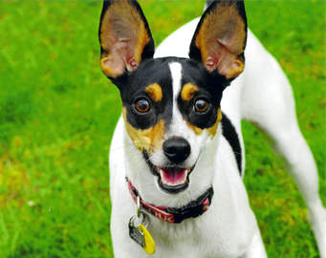
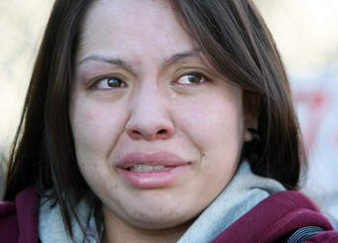
RABIES
Epidemiology
 Acute rapid progressive & highly fatal viral disease of CNS caused by Lyssavirus type 1.
 Zoonotic disease of warm blooded animals (dogs, cats , bats, racoons, skunks, foxes )
 Transmitted to man by bite of rabid animal.
 Non-bite exposures : aerosols; generated in labs , caves with bats , corneal transplantation.
 Human to human transmission extremely rare.

Slide 15
Pathogenesis
Incubation period : 20-90 days.
 STAGES:
Virus inoculated by bite.
Replication in muscles: virus binds to nicotinic acetylcholine receptors
Retrograde axonal transport :Spreads centripetally along peripheral nerves towards CNS( ~ 250 mm/day).
CNS dissemination

Slide 16
Most characteristic pathologic finding – Negri body
Eosinophilic cytoplasmic inclusion in neurons composed of rabies virus proteins & viral RNA.
Not observed in all cases of rabies.
Commonly seen in hippocampus & cerebellum.

Slide 17
Stage1:
Prodromal features 2-10 days :
• Fever
• Malaise • Headache • Vomiting • Anxiety • Agitation
• Pain / paresthesias at the site of exposure

Slide 18
Stage 2: early Encephalitic ( 80%)
Fever • Confusion •Hallucination •
Seizures , Combativeness
Autonomic dysfunction
(Hypersalivation , gooseflesh , cardiac arrythmias , priapism)
• Hydrophobia and Aerophobia
• Late complications ( cardiac failure , respiratory failure , multi organ failure

Slide 19
Late : encephalitis ( 80%)
Semi-conscious.
 Episodes of hyper excitability followed by complete lucidity
 Progress rapidly and coma followed within a day by death is rule unless course prolonged by supportive measures.
 Difficult to recognise late in clinical course when progression to coma has occured.

Slide 20
Stage 3: Paralytic Rabies (20%) :
Muscle weakness predominates.
Early & prominent flaccid muscle weakness often in bitten extremity & spreading to produce quadriparesis & facial weakness.
Sphincter involvement common.
Sensory involvement mild
Lacks cardinal features (hyperexcitability , hydrophobia , aerophobia)

Slide 21
DIAGNOSIS :
CSF analysis :
Lymphocytosis with elevated protein
Rabies virus specific antibodies in CSF
PCR highly sensitive
Direct Fluorescent Antibody testing
Skin biopsy
✓Corneal impressive smears – low diagnostic yield. ✓MRI brain – variable & non-specific. ✓EEG – non-specific abnormalities.

Slide 22
Differential Diagnois
✓Guillian Barre Syndrome :
✓Rabies Hysteria :shorter IP,
✓Allergic Encephalomyelitis ( Rabies Vaccine)
Tetanus
Poliomyelitis : flaccid paralysis early+ no S or A neuropathy
Notes:
 Paralytic rabies mimic GBS  Fever , bladder dysfunction , CSF pleocytosis favour rabies.

Slide 23
TREATMENT and prevention
No established treatment.
 Isolation in quiet room
( as bright light , noise , cold draughts precipitates spasms / convulsions )
 Sedatives to relieve anxiety.
 Hydration.
 Intensive respiratory & cardiac support

Slide 24
Post Exposure Prophylaxis
Local wound care
( all bite wounds/scratches washed with soap and water ) reduces chances up to 80%.
 Devitalised tissues debrided.
 Tetanus prophylaxis given.
 Suturing delayed
 Antibiotic treatment whenever indicated.
 Active immunisation by Rabies vaccine.
 Passive immunisation by Human Rabies Immuno Globulins (HRIG )

Slide 25
Indication of AntiRabies Treatment
If animal shows signs of rabies / dies within 10 days of observation
If biting animal cannot be traced / identified.
All bites by wild animals.
Lab tests ( Flourescent Rabies antibody test , Test for Negri bodies in brain of biting animal ) positive for rabies.

